Slide 1

Academic Session 2025-26
Even Semester Jan-May 2025
UNIVERSITY INSTITUTE OF ENGINEERING
AIT-CSE (AIML)
CS221: B.E. CSE (AIML)
5th Semester
ADVANCED MACHINE LEARNING & MATHEMATICAL MODELLING
(23CSH-382)
Unit No. 1 Chapter No. 1 Lecture No. 9, 10 & 11
Topic: Gradient Descent (GD), Stochastic GD & Mini-Batch GD Algorithms
Mr. Siddharth Kumar (E12853) Assistant Professor

Slide 2
COURSE OBJECTIVES
1
The course aims to:
To develop a strong mathematical foundation for regression-based predictive modelling using calculus, matrix algebra, and probability theory.
To provide an in-depth understanding of supervised classification algorithms including KNN, Support Vector Machines, and ensemble-based boosting approaches.
To equip learners to implement clustering and probabilistic reasoning models such as Spectral Clustering, Markov Chains, Bayesian Networks, and HMMs.
To cultivate the ability to design neural networks, implement multilayer perceptron, and optimize training using backpropagation and regularization strategies.
To expose students to advanced deep learning frameworks, feature abstraction hierarchies, and performance enhancement through hyper-parameter tuning & dropout.

Slide 3

COURSE OUTCOMES
2
On completion of this course, the students shall be able to:
CO1 | Recall the foundational concepts, terminology, and mathematical principles underlying regression, classification and clustering approaches.
CO2 | Illustrate the working mechanisms, characteristics, and theoretical concept of regression, clustering and classification techniques in machine learning.
CO3 | Apply appropriate regression, clustering and classification algorithms to solve real-world machine learning tasks while addressing performance constraints.
CO4 | Analyze and evaluate machine learning models using performance parameters to identify the best-suited techniques for specific applications regression, clustering and classification algorithms.
CO5 | Design and implement optimized machine learning solutions by integrating regression, clustering and classification models to solve complex predictive and decision-making problems.

Slide 4
Unit-I Syllabus
3
Unit-1 | Regression | Contact Hours: 15
Regression | Linear and Polynomial Regression, Maxima and Minima of Function of One Variable, Rank, Eigen Values and Eigen Vectors, Positive & Negative Definite/Semi-definite Matrices
Error Estimation | Maxima and Minima of Function of Several Variables, Convexity of Errors Function, Building Simple Linear Regression Model by Solving Normal Equations, Gradient Descent, Stochastic & Mini-batch Gradient Descent Algorithm
Probability Theory | Discrete Probability Distributions, Continuous Probability Distributions, Normal Distribution and t-Distributions, RSE, R²

Slide 5
SUGGESTIVE READINGS
4
Text Books / Reference Books:
TEXT BOOKS
T1: Massaron, L., & Boschetti, A. (2016). Regression analysis with Python. Packt Publishing Ltd.
T2: Jajuga, K., Sokolowski, A., & Bock, H. H. (Eds.). (2012). Classification, clustering, and data analysis: recent advances and applications.
T3: Bishop, C. M., & Bishop, H. (2023). Deep learning: Foundations and concepts. Springer Nature.
REFERENCE BOOKS
R1: Matloff, N. (2017). Statistical regression and classification: from linear models to machine learning. Chapman and Hall/CRC.
R2: Jajuga, K., Sokolowski, A., & Bock, H. H. (Eds.). (2012). Classification, clustering, and data analysis: recent advances and applications.
R3: Vishnoi, V. K., Chauhan, N. R., & Kumar, K. (2024). An introduction to deep learning. Xoffencer publication.

Slide 6
Table of Contents
5
Gradient Descent
Stochastic Gradient Descent Algorithms
Mini-Batch Gradient Descent Algorithms

Slide 7
Gradient Descent
6
Gradient Descent is a key optimization algorithm in machine learning used to minimize cost functions by iteratively adjusting parameters.
Gradient Descent is one of the most essential optimization algorithms in machine learning and deep learning.
It is used to minimize a function by iteratively adjusting its parameters in the direction of the steepest descent, as defined by the negative of the gradient.
This technique is widely used in training machine learning models, particularly in linear regression, logistic regression, and neural networks.
In this chapter, we will explore the concept of gradient descent, its working mechanism, types and challenges.

Slide 8
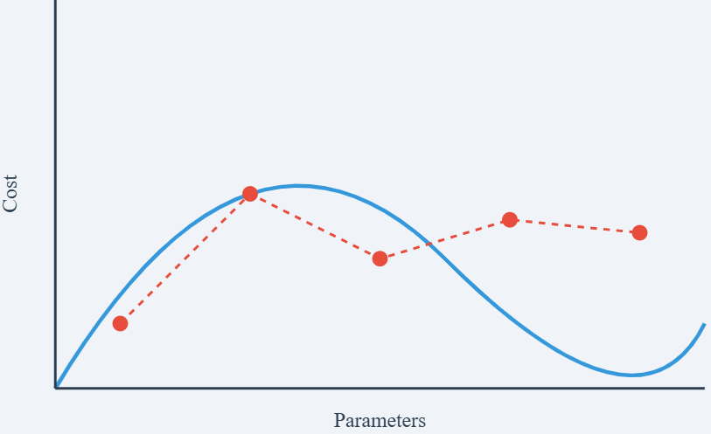
Gradient Descent
7
What is Gradient Descent?
Gradient descent is the backbone of the learning process for various algorithms, including linear regression, logistic regression, support vector machines, and neural networks which serves as a fundamental optimization technique to minimize the cost function of a model by iteratively adjusting the model parameters to reduce the difference between predicted and actual values, improving the model's performance.
Figure-1: Gradient Descent Curve

Slide 9
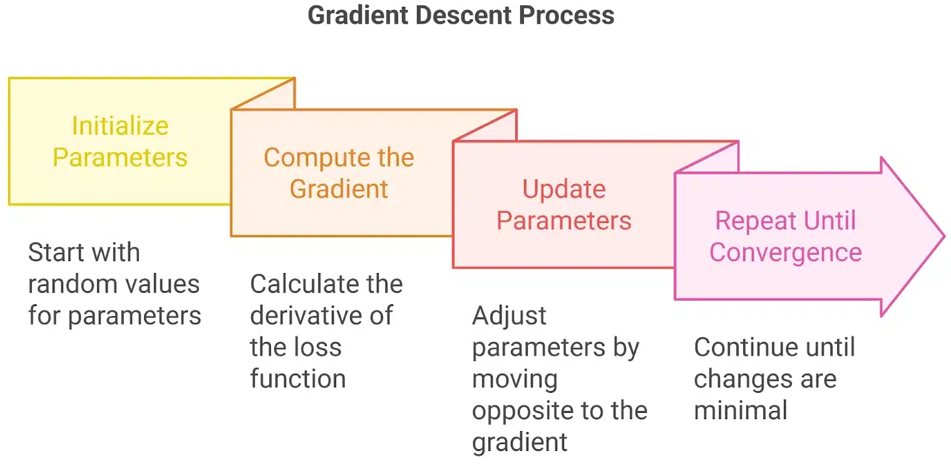
Gradient Descent
8
The cost function (or loss function) measures how well the model's predictions match the actual data. By iteratively adjusting the parameters in the direction that reduces the cost function, the model improves its accuracy.
How Gradient Descent Works?
Initialize Parameters: Start with random values for the parameters (weights and biases).
Compute the Gradient: Calculate the derivative (gradient) of the loss function with respect to each parameter.
Figure-2: Gradient Descent Process

Slide 10
Gradient Descent
9
Update Parameters: Adjust the parameters by moving in the opposite direction of the gradient:
Key points about the formula
θ = θ - α * ∇J(θ)
Where: θ represents model parameters
α (learning rate) controls step size
∇J(θ) is the gradient/slope of the cost function
Repeat Until Convergence: Continue updating parameters until the change is minimal or a stopping criterion is met.

Slide 11
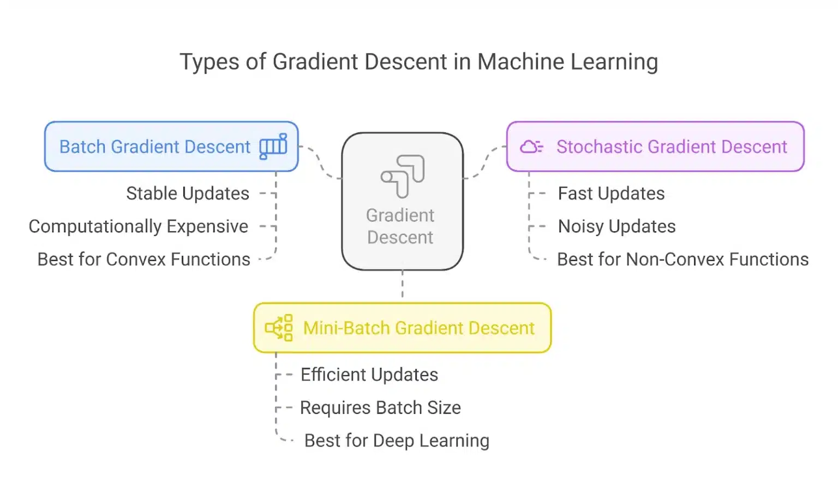
Gradient Descent
10
Types of Gradient Descent
Gradient Descent comes in different variations based on how much data is used to compute the gradient at each step.
These variations impact the speed, stability, and accuracy of convergence in machine learning models. Below are the three main types of Gradient Descent:
Figure-3: Types of Gradient Descent

Slide 12
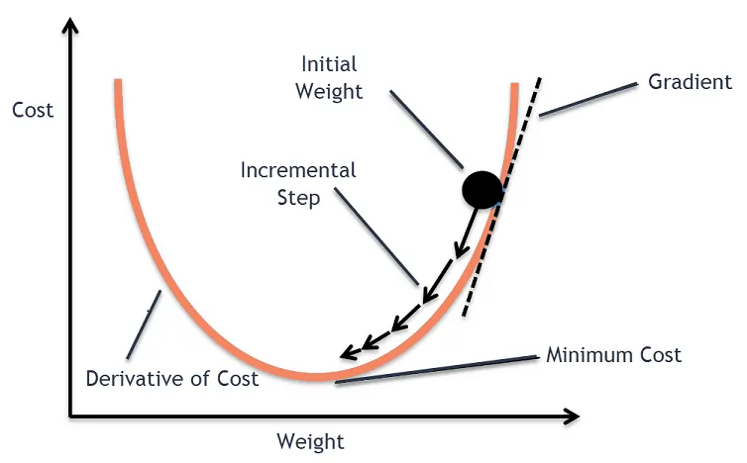
Gradient Descent
11
Gradient descent was originally proposed by CAUCHY in 1847. It is also known as the steepest descent. The goal of the gradient descent algorithm is to minimize the given function (say, cost function). To achieve this goal, it performs two steps iteratively:
Compute the gradient (slope), the first-order derivative of the function at that point.
Make a step (move) in the direction opposite to the gradient. The opposite direction of the slope increases from the current point by alpha times the gradient at that point.
Figure-4: Working of Gradient Descent

Slide 13
Types of Gradient Descent
12
The choice of gradient descent algorithm depends on the problem at hand and the size of the dataset. Batch gradient descent is suitable for small datasets, while stochastic gradient descent algorithm is more suitable for large datasets. Mini-batch is a good compromise between the two and is often used in practice.
Batch Gradient Descent
Batch gradient descent updates the model’s parameters using the gradient of the entire training set. It calculates the average gradient of the cost function for all the training examples and updates the parameters in the opposite direction.
Batch gradient descent guarantees convergence to the global minimum but can be computationally expensive and slow for large datasets.

Slide 14
Types of Gradient Descent
13
Stochastic Gradient Descent
Stochastic gradient descent updates the model’s parameters using the gradient of one training example at a time.
It randomly selects a training dataset example, computes the gradient of the cost function for that example, and updates the parameters in the opposite direction.
Stochastic gradient descent is computationally efficient and can converge faster than batch gradient descent.
However, it can be noisy and may not converge to the global minimum.

Slide 15
Types of Gradient Descent
14
Mini-Batch Gradient Descent
Mini-batch gradient descent updates the model’s parameters using the gradient of a small batch size of the training dataset, known as a mini-batch.
It calculates the average gradient of the cost function for the mini-batch and updates the parameters in the opposite direction.
The mini-batch gradient descent algorithm combines the advantages of batch and stochastic gradient descent.
It is the most commonly used method in practice. It is computationally efficient and less noisy than stochastic gradient descent while still being able to converge to a good solution.

Slide 16
Advantages and Disadvantages
15
Advantages
Easy to use: It’s like rolling the marble yourself – no fancy tools needed, you just gotta push it in the right direction.
Fast updates: Each push (iteration) is quick, you don’t have to spend a lot of time figuring out how hard to push.
Memory efficient: You don’t need a big backpack to carry around extra information, just the marble and your knowledge of the hill.
Usually finds a good spot: Most of the time, the marble will end up in a pretty flat area, even if it’s not the absolute flattest (global minimum).

Slide 17
Advantages and Disadvantages
16
Disadvantages
Slow for giant hills (large datasets): If the hill is enormous, pushing the marble all the way down each time can be super slow. There are better ways to roll for these giants.
Can get stuck in shallow dips (local minima): The hill might have many dips, and the marble could get stuck in one that isn’t the absolute lowest. It depends on where you start pushing it from.
Finding the perfect push (learning rate): You need to figure out how far to push the marble (learning rate). If you push too weakly, it’ll take forever to get anywhere. Push too hard, and it might roll right past the flat spot.

Slide 18
Challenges of Gradient Descent
17
Some of these challenges include:
Local Optima: Gradient descent can converge to local optima instead of the global optimum, especially if the cost function has multiple peaks and valleys.
Learning Rate Selection: The choice of learning rate can significantly impact the performance of gradient descent. If the learning rate is too high, the algorithm may overshoot the minimum, and if it is too low, the algorithm may take too long to converge.
Overfitting: Gradient descent can overfit the training data if the model is too complex or the learning rate is too high. This can lead to poor generalization performance on new data.

Slide 19
Challenges of Gradient Descent
18
Convergence Rate: The convergence rate of gradient descent can be slow for large datasets or high-dimensional spaces, making the algorithm computationally expensive.
Saddle Points: In high-dimensional spaces, saddle points can cause the gradient of the cost function to get stuck in a plateau, preventing gradient descent from converging to a minimum.
Researchers have developed several variations of gradient descent algorithms to overcome these challenges, such as adaptive learning rate, momentum-based, and second-order methods. Additionally, choosing the right regularization method, model architecture, and hyperparameters can also help improve the performance of the gradient descent algorithm.

Slide 20
Gradient Descent in Linear Regression
19
Gradient descent minimizes the Mean Squared Error (MSE) which serves as the loss function to find the best-fit line.
Gradient Descent is used to iteratively update the weights (coefficients) and bias by computing the gradient of the MSE with respect to these parameters.
Since MSE is a convex function gradient descent guarantees convergence to the global minimum if the learning rate is appropriately chosen. For each iteration:
The algorithm computes the gradient of the MSE with respect to the weights and biases.
It updates the weights (w) and bias (b) using the formula:
Calculating the gradient of the log-loss with respect to the weights.

Slide 21
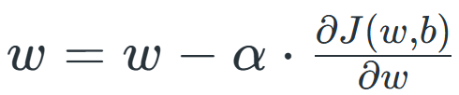
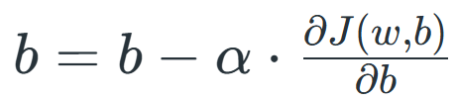
Gradient Descent in Linear Regression
20
Updating weights and biases iteratively to maximize the likelihood of the correct classification:
For Weight,
For Bias,
The formula is the parameter update rule for gradient descent, which adjusts the weights w and biases b to minimize a cost function.
This process iteratively adjusts the line's slope and intercept to minimize the error.

Slide 22
Applications of the Topic
21
Here are applications:
Training regression models (linear, logistic) by minimizing loss functions.
Optimizing parameters of neural networks and deep learning models.
Training models on very large datasets where full batch processing is expensive.
Online / streaming learning where data arrives continuously (e.g., click prediction, ads).
Training deep learning models (CNNs, RNNs etc.) on image, text, and speech data.
Practical training of deep learning models using batches (e.g., 32/64/128 samples).
Efficient use of GPUs/TPUs through vectorized operations over mini-batches.
Achieving a balance between speed (like SGD) and stability (like batch GD) in convergence.

Slide 23
Summary of the Lecture
22
The lecture discussed gradient descent and its variants as key techniques for optimizing machine learning models. Gradient descent minimizes error by updating parameters using the full dataset but can be slow for large data. Stochastic Gradient Descent speeds up training by updating parameters using one sample at a time, though it is noisier. Mini-Batch Gradient Descent offers a balance by using small batches, making training faster and more stable. Overall, the lecture highlighted how these methods differ in speed, stability, and suitability for large datasets.
Mini-Batch Gradient Descent was discussed as a balanced approach that processes small groups of samples at each step, offering faster computation than batch GD while maintaining more stable convergence than SGD.

Slide 24
Next Lecture
23
In next lecture, we are going to cover:
Discrete Probability Distributions
Continuous Probability Distributions
Normal Distribution and T Distributions
RSE and R2

Slide 25
Quiz/ FAQ’s
24
Define maxima and minima for a function of several variables.
Explain the condition for local maxima/minima using partial derivatives.
What is the Hessian matrix and how is it used in optimization?
What is a convex function? Give its mathematical definition.
Why is convexity important in machine learning?
Explain how convexity ensures the existence of a global minimum.
Derive the normal equations for linear regression.
State the formula for computing regression coefficients using normal equations.
Compare gradient descent and normal equation methods.

Slide 26
References/ Articles/ Videos
25
Text/ Reference Books
T1 | Massaron, L., & Boschetti, A. (2016). Regression analysis with Python. Packt Publishing Ltd.
T2 | Jajuga, K., Sokolowski, A., & Bock, H. H. (Eds.). (2012). Classification, clustering, and data analysis: recent advances and applications.
T3 | Bishop, C. M., & Bishop, H. (2023). Deep learning: Foundations and concepts. Springer Nature.
R1 | Matloff, N. (2017). Statistical regression and classification: from linear models to machine learning. Chapman and Hall/CRC.
R2 | Jajuga, K., Sokolowski, A., & Bock, H. H. (Eds.). (2012). Classification, clustering, and data analysis: recent advances and applications.
R3 | Vishnoi, V. K., Chauhan, N. R., & Kumar, K. (2024). An introduction to deep learning. Xoffencerpublication.

Slide 27
Faculty-curated videos, NPTEL, Coursera, LinkedIn, or other relevant learning resources
26
https://www.geeksforgeeks.org/machine-learning/gradient-descent-algorithm-and-its-variants/
https://www.analyticsvidhya.com/blog/2020/10/how-does-the-gradient-descent-algorithm-work-in-machine-learning/
https://www.coursera.org/learn/ismdl?source=admin-share
https://www.coursera.org/learn/ai-for-real-world-intelligence-systems?source=admin-share
https://www.coursera.org/learn/ai-for-real-world-intelligence-systems?source=admin-share
https://www.coursera.org/learn/deep-learning-applications-in-vision?source=admin-share

Slide 28
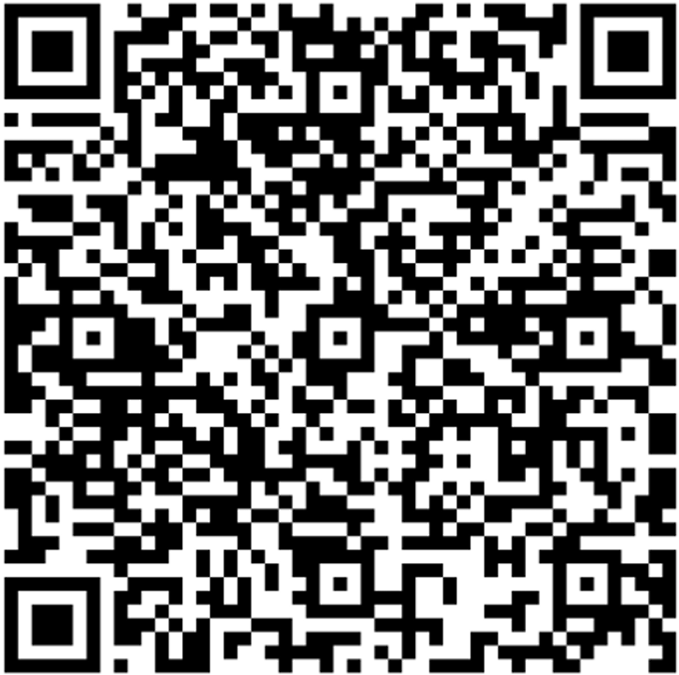
27
Class-Wise Feedback
Note: Scan this QR code to provide anonymous feedback.

Slide 29
28
Thank You
For queries
Email: siddharth.e12853@cumail.in

